Slide 1
MODULE 2 VIRTUALIZATION

Slide 2
Virtualization
Virtual workspaces:
An abstraction of an execution environment that can be made dynamically available to authorized clients by using well-defined protocols,
Resource quota (e.g. CPU, memory share),
Software configuration (e.g. O/S, provided services).
Implement on Virtual Machines (VMs):
Abstraction of a physical host machine,
Hypervisor intercepts and emulates instructions from VMs, and allows management of VMs,
VMWare, Xen, etc.
Provide infrastructure API:
Plug-ins to hardware/support structures
App
App
App
OS
OS
OS
Hypervisor
Hardware
Virtualized Stack

Slide 3
Virtual Machines
VM technology allows multiple virtual machines to run on a single physical machine.
App
App
App
App
App
Xen
Guest OS
(Linux)
Guest OS
(NetBSD)
Guest OS
(Windows)
VMWare
VM
VM
VM
Virtual Machine Monitor (VMM) / Hypervisor
UML
Denali
Hardware
etc.

Slide 4
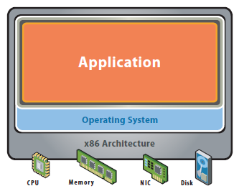
Traditional App/Server
Notes:
Single OS image per machine
Software and hardware tightly coupled
Running multiple applications on same machine
Underutilized resources
Inflexible and costly infrastructure

Slide 5
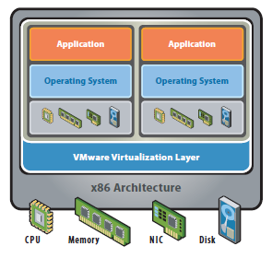
Virtual Server Model
Notes:
Hardware-independence of operating system and applications
Virtual machines can be provisioned to any system
Can manage OS and application as a single unit by encapsulating them into virtual machines

Slide 6
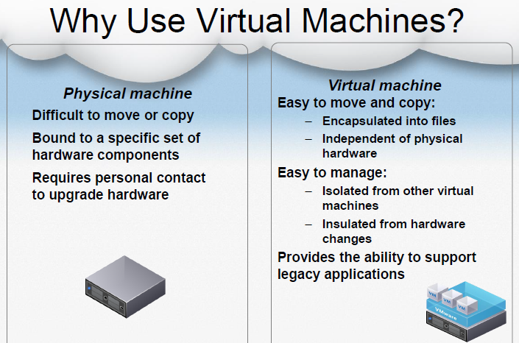

Slide 7
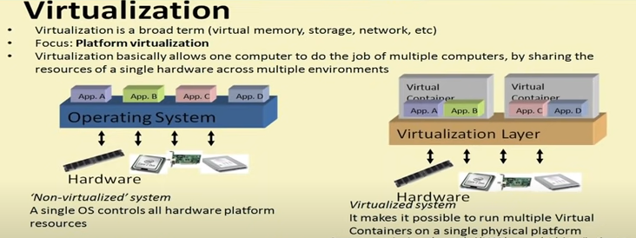

Slide 8
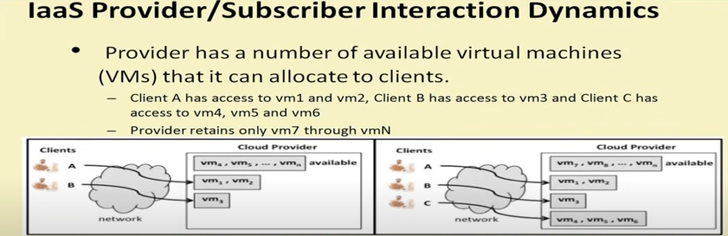

Slide 9
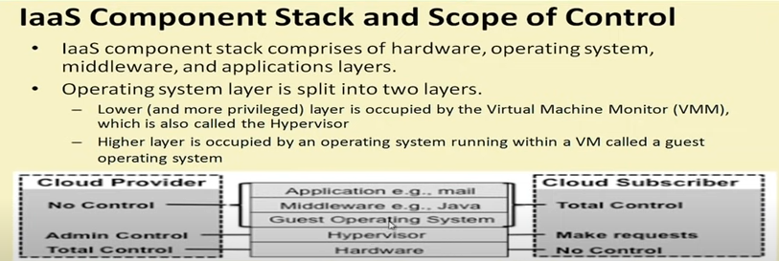
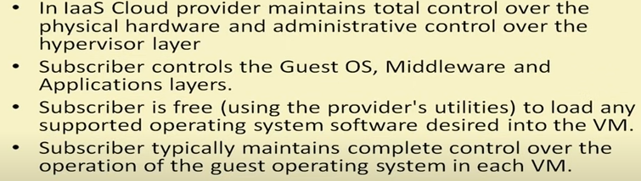

Slide 10
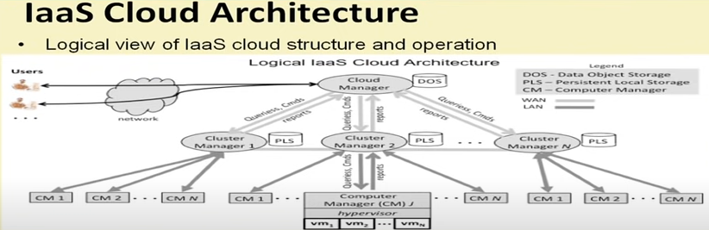

Slide 11
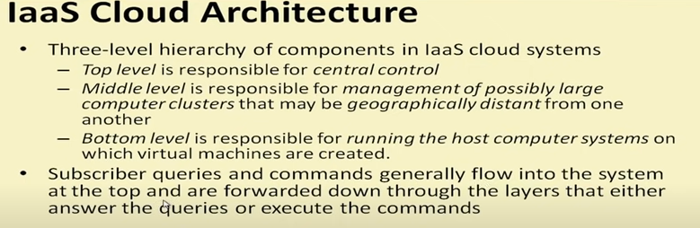

Slide 12
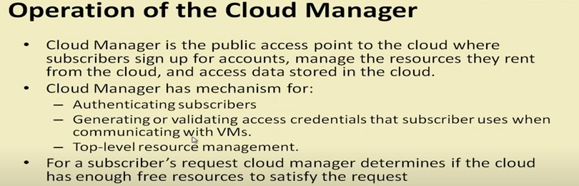
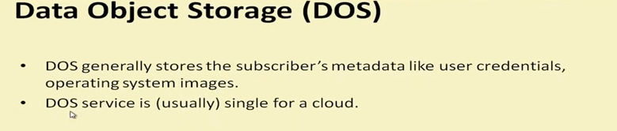

Slide 13
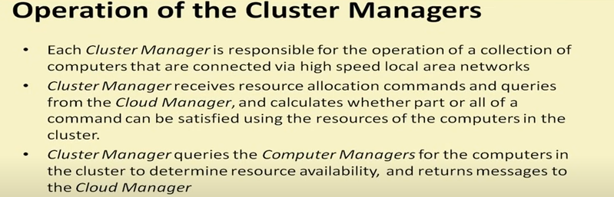
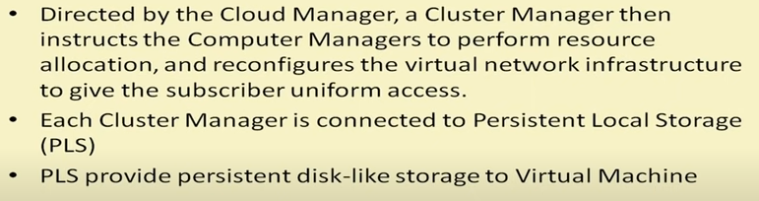

Slide 14
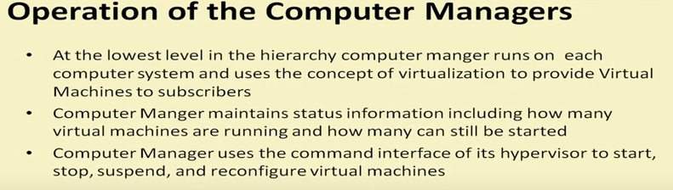

Slide 15
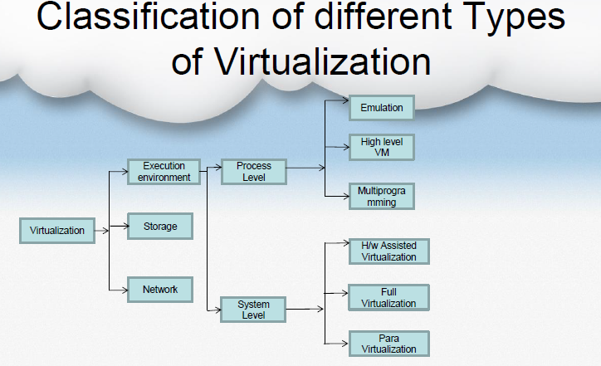

Slide 16
Hardware Virtualization
Full virtualization – almost complete simulation of the actual hardware to allow software, which typically consists of a guest operating system, to run unmodified.
e.g. VMWare ESXi and Microsoft virtual server
Partial virtualization – some but not all of the target environment attributes are simulated. As a result, some guest programs may need modifications to run in such virtual environments.
e.g. Address space virtualization used in time sharing systems
Paravirtualization – a hardware environment is not simulated; however, the guest programs are executed in their own isolated domains, as if they are running on a separate system. Guest programs need to be specifically modified to run in this environment.

Slide 17
Full Virtualization | Para virtualization
In Full virtualization, virtual machines permit the execution of the instructions with the running of unmodified OS in an entirely isolated way | In Para virtualization, a virtual machine does not implement full isolation of OS but rather provide a different API which is utilized when OS is subjected to alteration
F. V. is less secure | P.V. is more secure
F. V. uses binary translation and a direct approach as a technique for operations | While P.V. uses hypercalls at compile time for operation
It is slow | Comparatively fast
More portable and compatible | Less portable and compatible
e.g. Microsoft | e.g. Microsoft Hyper-V, Xen etc.
It supports all guest operating systems without modification | Guest OS has to be modified and only a few OS supports it

Slide 18
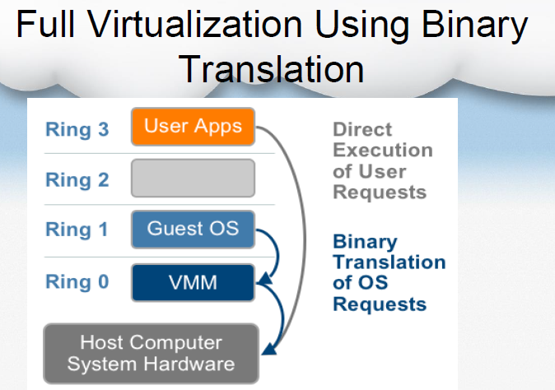

Slide 19
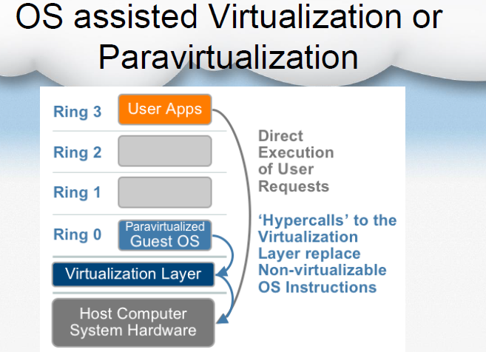

Slide 20
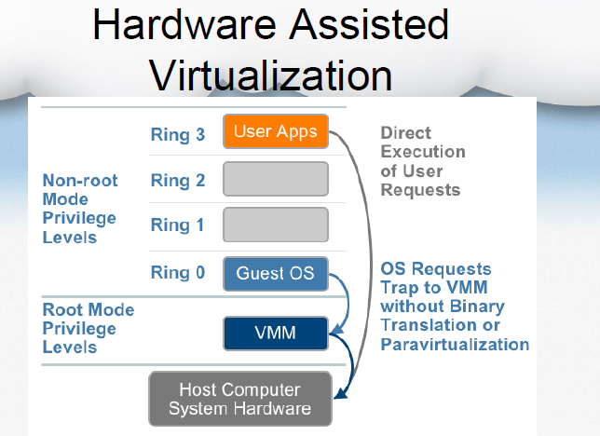

Slide 21
Software Virtualization
Operating system-level virtualization, hosting of multiple virtualized environments within a single OS instance.
Application virtualization and workspace virtualization, the hosting of individual applications in an environment separated from the underlying OS. Application virtualization is closely associated with the concept of portable applications.
Service virtualization, emulating the behavior of dependent (e.g., third-party, evolving, or not implemented) system components. It virtualizes only specific slices of dependent behavior critical to the execution of development and testing tasks.

Slide 22
Storage Virtualization
Storage virtualization, the process of completely abstracting logical storage from physical storage
Distributed file system, any file system that allows access to files from multiple hosts sharing via a computer network
Virtual file system, an abstraction layer on top of a more concrete file system, allowing client applications to access different types of concrete file systems in a uniform way

Slide 23
Storage Virtualization
Storage hypervisor, the software that manages storage virtualization and combines physical storage resources into one or more flexible pools of logical storage
Virtual disk drive, a computer program that emulates a disk drive such as a hard disk drive or optical disk drive

Slide 24
Network Virtualization
Network virtualization, creation of a virtualized network addressing space within or across network subnets
Virtual private network (VPN), a network protocol that replaces the actual wire or other physical media in a network with an abstract layer, allowing a network to be created over the Internet

Slide 25
Hypervisor
A hypervisor or virtual machine monitor (VMM) is a piece of computer software, firmware or hardware that creates and runs virtual machines.
A computer on which a hypervisor is running one or more virtual machines is defined as a host machine.
Each virtual machine is called a guest machine.

Slide 26
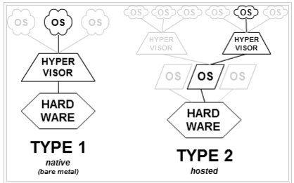

Slide 27
Type-1, native or bare-metal hypervisors
These hypervisors run directly on the host's hardware to control the hardware and to manage guest operating systems.
Examples:
Oracle VM Server for SPARC,
Oracle VM Server for x86
Citrix XenServer
VMware ESX/ESXi
MicrosoftHyper-V 2008/2012.

Slide 28
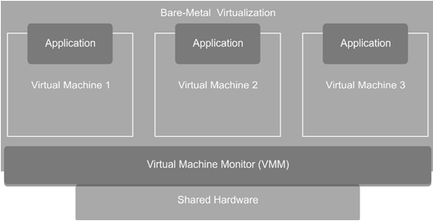
The VMM does not rely on the host system for pass-through permissions
In the bare-metal virtualization technique, you have several options to access I/O devices from the guest systems
VMM can have direct communication with the I/O devices
partitioning is another method through which I/O devices can be approached by the hypervisor

Slide 29
Benefits and Drawbacks:
VMMs of the bare-metal type may be used for binding the interrupt latency and enabling deterministic performance
A single hardware platform can be used to run real-time and general-purpose OSs in parallel
The hypervisor must include supporting drivers for hardware platforms, apart from including the drivers required for sharing the I/O devices amongst the guest systems
It is harder to install the VMMs in a bare-metal structure rather than in the hosted structure

Slide 30
Type-2 or hosted hypervisors
These hypervisors run on a conventional operating system just as other computer programs do.
Type-2 hypervisors abstract guest operating systems from the host operating system.
Examples:
VMware Workstation
VMware Player
VirtualBox

Slide 31
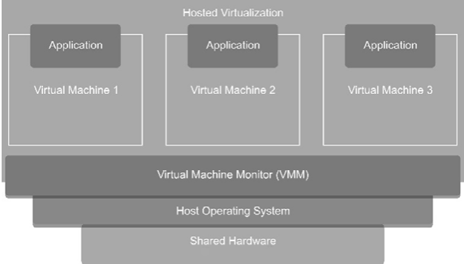
Enables you to run various guest application windows of your own on top of a base OS with the help of the VMM
Guest OSs in this virtualization structure have limited access to the I/O devices
The I/O connections to a given physical system are owned by the host system only while their emulated view is presented (when possible) by the VMM to every single guest machine running on the same base system

Slide 32
Benefits and Drawbacks:
With the hosted virtualization structure, multiple guest systems are easily installed, configured, and run
Setting VMWare Workstation on a Windows-based system through the basic Windows installer is a matter of only a few minutes
After the VMM is installed, you can run several guest systems on various platforms without any extra physical resource requirement
The hosted structure is incapable of providing a pass-through to many I/O devices
Performance of the hosted system may be downgraded, because the I/O requests made by the guest systems must be passed through a host OS
A real-time OS is not supported in this structure either

Slide 33
Benefits of Virtualization
Maximizing Resources—The pay-as-you-go facility of virtualization helps organizations utilize the maximum amount of required resources.
Reducing Hardware Costs—When you have no requirements for infrastructure maintenance, the cost for hardware reduces automatically. You do not require installing large servers, huge disk space, or expensive databases, because you can avail these services virtually, anytime

Slide 34
Minimizing Maintenance Requirements—The lesser is the hardware with you, the lesser is the requirement for maintenance. Virtualization helps you run multiple OSs on a single hardware, which reduces the hardware cost, as well as the need for maintaining the hardware
Enjoying Benefits of OS Services—Virtualization helps you take advantage of the facilities offered by different Oss
Using Multiple Systems—Use of multiple systems is made easy with the help of virtualization.

Slide 35
Testing Beta Software and Maintaining Legacy Applications—
If the OS you use for testing software releases gets corrupted, you can still continue your work uninterrupted with the other system running on the same machine.
Likewise, if you have a legacy system on which certain applications are run and supported, you can continue with that without requiring to port programs to a different OS.

Slide 36
Increasing System Security—You can increase the security of your systems through virtualization. Individual systems that are run on virtual machines can be separated from each other. This helps avoid the requirement for different computers to be run on different levels of security without being utilized to their full capacity

Slide 37
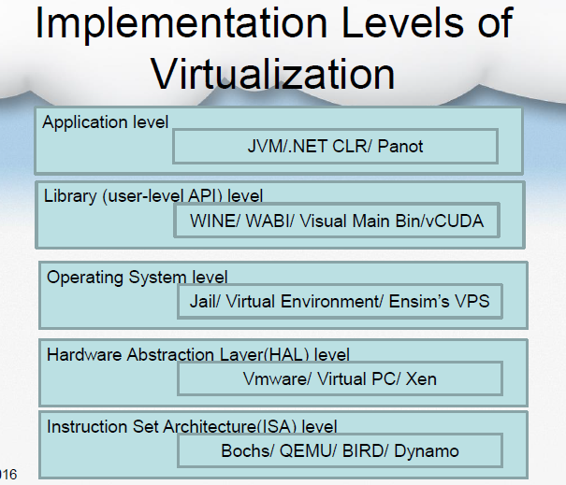

Slide 38
1. Virtualization at the Instruction Set Architecture (ISA) Level:
Transforming the physical architecture of the system’s instruction set completely into software
Guest systems issue instructions for the emulator to process and execute
The instructions are received by the emulator, which transforms them into a native instruction set
These native instructions are run on the host machine’s hardware
Instructions include both the processor-oriented instructions and the I/O-specific ones

Slide 39
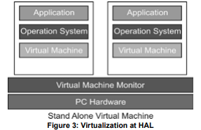
2. Virtualization at the Hardware Abstraction Layer (HAL):
Time spent in interpreting the instructions issued by the guest platform into the instructions of the host platform is reduced
It finds similarities that exist between the architectures of the systems
Virtualization utilizes the native hardware for all its computation and processing by mapping the virtual resources into physical resources
It increases the efficiency of the
virtual machine in handling various tasks
Cannot fully virtualize all the
platforms through this technique

Slide 40
3. Virtualization at the OS Level:
To overcome the issues of redundancy and time consumption (to avoid duplicity OS in native & virtual)
Higher level virtualization
Sharing both hardware and OS
The virtualization layer replicates the operating environment, which is established on the physical machine to provide a VE for the application by creating partitions for each virtual system, whenever demanded

Slide 41
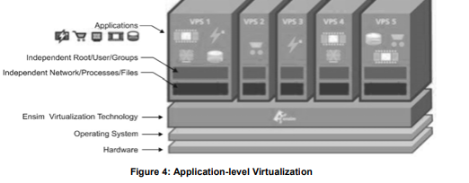
4. Virtualization at the Application Level :
The user level programs and OSs are executed on applications that behave like real machines
I/O mapped input/output processing (in which special I/O instructions are issued for hardware manipulation) or a memory mapped input/output processing technique (in which a small part of memory is mapped to the I/O and then the memory is manipulated) is used to deal with the hardware.
The set of instructions for an application is defined by the machine specifically for itself
You can run your applications
on these virtual machines as if
you are running your applications
on a physical machine
Less Secure

Slide 42
5. Virtualization at the Programming
Language Level or Library Level :
Programming the applications in most systems requires an extensive list of Application Program Interfaces (APIs) to be exported by implementing various libraries at the user-level
At the user-level library implementation, a different VE is provided in this kind of abstraction
VE is created above the OS layer, which can expose a different class of binary interfaces altogether
Implementation of a different set of Application Binary Interfaces (ABIs) and/or APIs being implemented through the base system and performing the function of ABI/API emulation

Slide 43
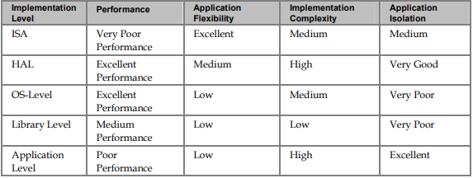
Comparison between the Implementation Levels of Virtualization

Slide 44
Virtualization Design Requirements
i. Equivalence Requirement—
A machine that is developed through virtualization must have a logical equivalence with the real machines
The emulated system must be able to execute all the applications and programs that are designed to execute on the real machines with the only considerable exception of timing
ii. Efficiency Requirement—
The virtual machine must be as efficient in its performance as a real system
Virtualization is primarily done with a purpose of getting efficient software without the physical hardware

Slide 45
iii. Resource Control Requirement—
A typical computer system is a combination of various resources, including processors, memory, and I/O devices. All these resources must be managed and controlled effectively by the VMM
VMM must be in a state of enforcing isolation between the virtualized systems
The virtual machines or the VMM should not face any interference in their operations due to other machines in any manner, barring a case where interference is entitled to the requirements for efficiency

Slide 46
Open Source Virtualization Technology
Kernel-based Virtual Machine (KVM) and Xen are two open-source technologies that provide virtualization support for the Linux operating system
KVM provides virtualization support for Operating Systems (OSs) that are based on x86 hardware coupled with virtualization extensions
The infrastructure for virtualization, which provided by the kernel module in KVM technology, requires a modified Quick EMUlator (QEMU) for the implementation of virtualization
KVM is used to host multiple VMs that run Linux OS images or Windows OS images without modification
Each of the VMs has been provided with its own set of virtualized hardware components that include a network card, disk, graphic adapter, etc.

Slide 47
Xen Hypervisor
Xen hypervisor is the only bare-metal hypervisor available as open source
Through Xen, a VM (or a host) can run a number of OS images or multiple different OSs in parallel
For example, the Xen hypervisor provides server virtualization, desktop virtualization, security applications, IaaS, and embedded and hardware appliances
The Xen hypervisor is the most widely used virtualization technique in the production environment at present

Slide 48
The key features of the Xen hypervisor include the following:
Robustness and Security: The technique follows the microkernel design approach, offering a higher level of robustness and security to the applications than other hypervisors.
Scope for Other Operating Systems: Not only can the Xen hypervisor be run on the Linux OS working as the main control stack but it can also be adjusted to other systems as well
Isolation of Drivers from the Rest of the System: The main device drivers can be allowed by the Xen hypervisor to run inside a VM, and in case the driver suffers a crash or is compromised, it can be restarted by rebooting the VM that contains the driver without causing any effect on the other parts of the system.

Slide 49
Continue…
Support for Paravirtualization:
The Xen hypervisor provides optimization support for paravirtualized guests so that they can be run as VMs. This feature helps guests run faster than the hypervisors providing the hardware extension. Hardware having no support for virtualization extension can also be used with the Xen hypervisor
* Note: KVM is Type 2 hypervisor where Xen is Type 1 hypervisor

Slide 50
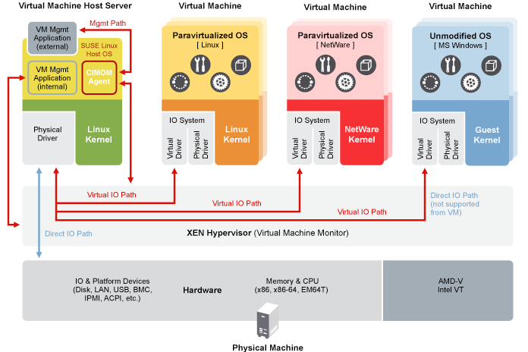
Xen Virtualization Architecture

Slide 51
Thank You!

